Slide 1
A Presentation ON Optimization of Network Flows
PRESENTED BY,
Chinmay A. Patane
As a part of Individual Project in
Quantitative Management Modelling
Department of Management and Information Systems
KENT STATE UNIVERSITY, OHIO-44242

Slide 2
Contents
Problem Statement
Maximum Flow Problem
Ford Fulkerson Algorithm
Minimum Cut Concept
Minimum Cost Flow Problem
Minimum Spanning Tree Problem

Slide 3
PROBLEM STATEMENT : Why Network Optimization Required
In any organization where one task can be done in many number of ways, i.e. more than one solutions are available for a single task, a problem forms a network
It has one source and one destination, and number of paths are available between the source and the destination
Each path is a solution
Desired solution is the one which gives you maximum or minimum outcome, based on the situation
Solution may contain use of one path or multiple paths

Slide 4
Contents
Problem Statement
Maximum Flow Problem
Ford Fulkerson Algorithm
Minimum Cut Concept
Minimum Cost Flow Problem
Minimum Spanning Tree Problem

Slide 5
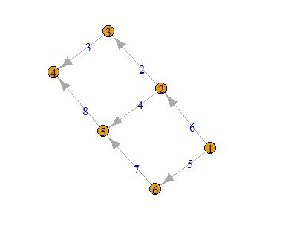
Maximum Flow Problem
Here we need to determine the maximum flow between the source and the destination (or sink)
All the paths will be taken into consideration
Every path has a capacity, and the flow cannot be more than the path’s capacity
Except source and sink, for each node, incoming flow=outgoing flow
Most common applications include Airline Scheduling, Circulation and Demand Problem

Slide 6
Contents
Problem Statement
Maximum Flow Problem
Ford Fulkerson Algorithm
Minimum Cut Concept
Minimum Cost Flow Problem
Minimum Spanning Tree Problem

Slide 7
Ford Fulkerson Algorithm
Useful in calculating the maximum flow between the source and sink
Finds different valid paths from source to destination and then adds them up [1]
Algorithm assumes that:
On each node amount of flow may not be present
Capacities are integer Valued
On every arc there is a minimum flow of 1 unit
A good explanation about Ford Fulkerson Algorithm can be found here:
https://www.youtube.com/watch?v=sSgI072tN5k

Slide 8
Contents
Problem Statement
Maximum Flow Problem
Ford Fulkerson Algorithm
Minimum Cut Concept
Minimum Cost Flow Problem
Minimum Spanning Tree Problem

Slide 9
Minimum Cut Concept
In a network flow graph, cut those paths between any of the nodes so that there won’t be any path left from source to destination
Minimum Cut = Maximum Flow
Cuts in Graph= 2->3 and 5->4
∑ Capacities in minimum cut= Maximum Flow= 10 [3]

Slide 10
Contents
Problem Statement
Maximum Flow Problem
Ford Fulkerson Algorithm
Minimum Cut Concept
Minimum Cost Flow Problem
Minimum Spanning Tree Problem

Slide 11
Minimum Cost Flow Problem
Whenever a path with the minimum cost has to be determined, it is minimum cost problem
Each path has a certain cost associated with it
Going through the path adds up the cost of going through each arc
Finding a minimum flow is useful in getting shortest distance between the two locations, or getting a path which will cost minimum

Slide 12
Contents
Problem Statement
Maximum Flow Problem
Ford Fulkerson Algorithm
Minimum Cut Concept
Minimum Cost Flow Problem
Minimum Spanning Tree Problem

Slide 13
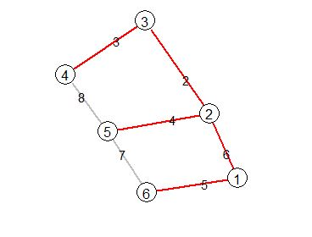
Minimum Spanning Tree
Spanning tree covers all the nodes with the arcs with minimum value
Does not consider the directions while counting
Gives approximate solution to Travelling Salesman Problem
Another common application include building of Networks

Slide 14
References
Jaehyun Park, “Network Flow Problems” ,CS 97SI , Stanford University, June 29, 2015, from https://web.stanford.edu/class/cs97si/08-network-flow-problems.pdf
Gabor Csardi “Package igraph”: R Documentation, July 21, 2017, from https://cran.r-project.org/web/packages/igraph/igraph.pdf
Manuel Fontenla, “Package Optrees: Optimum Trees in Weighted Graphs”, R Documentation, February 12, 2015, from https://cran.r-project.org/web/packages/optrees/optrees.pdf
Kevin Wayne, “Maximum Flow, Minimum Cut”, COS 226-Algorithms and Data Structures, Princeton University, Spring 2004, from http://www.cs.princeton.edu/courses/archive/spr04/cos226/lectures/maxflow.4up.pdf

Slide 15


